Slide 1
PRESENTATION FOLLOWS IGOR's UDEMY COURSE ON
JAVA OCP CERTIFICATION
(1Z0-809, Part 2)
https://www.udemy.com/course/ocp-1z0-809-23

Slide 2
04 — Lambda Built-In Functional Interfaces
05 — Java Stream API

Slide 3
FP00_PlanOfAttack
FP01_InnerClassesDemo
FP02_LambdaSyntax
FP03_UniversalAnalyzer
FP04_CollectionProcessing

Slide 4
Java Streams
— Stream API:
java.util.stream
A sequence of elements on which methods can be called, incl. in series
— Method chaining:
Multiple methods called within a single statement
a.k.a. "fluid API"
(based on Builder Design Pattern)
— Stream characteristics:
Immutability
Disposability
Sequential by default but can be parallelized

Slide 5
How to filter()
— The stream() method converts collection to a pipeline
— filter() relies on Predicate lambdas to select items
— Predicate<T>: boolean test(T obj)
— Example:
students.stream()
.filter(s -> s.name.toLowerCase().contains("h"))
.forEach(System.out::println); // Sasha, Masha, Natasha, Hannibal Lector …

Slide 6
Method References
— Sometimes the lambda simply calls a method, that's all it does:
— .forEach(student -> System.out.println(student));
— In such cases we could use a method reference:
Obfuscated!
No args!!!
— .forEach(System.out::println);
— There are 4 kinds of method references:
— ref to a static method: .map(String::valueOf)
— ref to an instance method: .map(String::hashCode)
— ref to an instance method of an arbitrary object of a particular type:
.map(String::compareToIgnoreCase)
— ref to a ctor: .map(String::new)

Slide 7
Method References
.map(MyMysteriousClass::gotcha)
.map(this::oops)

Slide 8

Method References

Slide 9
Method References
…
.map(Transaction::getTrader)
.map(Trader::getAddress)
.map(Address::getEmail)
.map(Email::getPrivateEmail)
…

Slide 10

The java.util.function Package
— Consists entirely of functional interfaces, e.g.:
— Consumer<T>: void accept(T obj)
— Supplier<T>: T get()
— Function<T,R>: R apply(T obj)
— Predicate<T>: boolean (T obj)
— Apart from functions, contains operators:
— UnaryOperator<T>

Slide 11


The java.util.function Package
— Also offers:
— primitive specializations
to consume a primitive: DoubleFunction<R>
to return a primitive: ToDoubleFunction<T>
— binary alternatives, e.g.:
BiFunction<T,U,R> BinaryOperator<T>

Slide 12

Stream Pipelines: a Bird's-Eye View
A stream pipeline is made up of:
a source, e.g., produced by stream(), generate(), iterate(), of(), range() …
zero or more intermediate operations, e.g., peek(), map(), filter(), distinct, limit() …
a single terminal operation, e.g., allMatch(), collect(), reduce(), forEach() …
Functional in nature
not a storage
possibly unbounded
Lazy operations:
Can be optimized
Perform only required work
can be either stateless or stateful
sequential or parallel
may or may not have an encounter order
lazy

Slide 13

Fibonacci Sequence
FP05_RecursiveFibo
FP06_MemoizedFibo
FP07_StreamingFibo
c.1170 – c. 1240–50

Slide 14


The map() Method
map(Function<? super T,? extends R> mapper)
transformation: names.stream().map(Cat::new)
data extraction: map(Transaction::getValue)
Primitive specializations:
mapToInt()
mapToLong()
mapToDouble()

Slide 15


Taking a peek()
peek(Consumer<? super T> action)
Resembles the tee command in Unix
The peek() method performs the operation specified by the lambda expression and returns the elements to the stream.

Slide 16

Short-circuiting Ops
May not evaluate the predicate on all elements
allMatch()
noneMatch()
Nondeterministic behavior
findFirst()
findAny()
anyMatch()

Slide 17
Short-circuiting Ops
May not evaluate the predicate on all elements
allMatch()
noneMatch()
Nondeterministic behavior
findFirst()
findAny()
anyMatch()

Slide 18

The Optional Class
Optional<T>
A container object that may or may not contain a non-null value
If a value is present, isPresent() returns true
get() returns the value
— but can be tricky
Lives in java.util
Primitive specializations:
OptionalInt
OptionalLong
OptionalDouble

Slide 19

The Optional Class
Methods that return an Optional<T>
find***()
min() / max()
reduce(BinaryOperator<T> accumulator)
Fimi mare
On Stream's primitive specializations
average()

Slide 20

Data Methods
Reduction down to a single value:
Sorting:
max(Comparator<? super T> comparator)
sorted() ← presumes natural ordering
min(Comparator<? super T> comparator)
sorted(Comparator<? super T> comparator)
count()
average()
presume primitive streams
sum()
Comparator<T> updates:
comparing(Function<? super T,? extends U> keyExtractor)
thenComparing(Comparator<? super T> other)
reversed() ← of this comparator
reversedOrder() ← relates to natural ordering

Slide 21

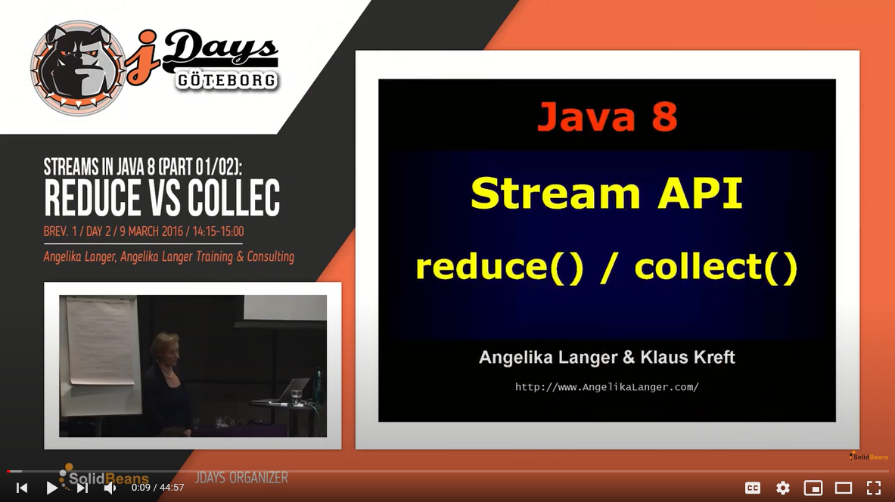
Reductions
Mutable
collect(Collector<? super T,A,R> collector)
Ex.: stream().collect(Collectors.toList())
collect( Supplier<R> supplier,
BiConsumer<R,? super T> accumulator,
BiConsumer<R,R> combiner)
Immutable
reduce( BinaryOperator<T> accumulator)
reduce( T identity,
BinaryOperator<T> accumulator)
reduce( U identity,
BiFunction<U,? super T,U> accumulator,
BinaryOperator<U> combiner)

Slide 22

The Collectors Class
averagingDouble(ToDoubleFunction<? super T> mapper)
produces the arithmetic mean of a double-valued function applied to the input elements
groupingBy(Function<? super T,? extends K> classifier)
grouping elements according to the classification function, and returning the result as a Map
partitioningBy(Predicate<? super T> predicate)
partitions the input elements according to the provided Predicate
joining()
concatenates the input elements into a String, in the encounter order

Slide 23

Originators
java.util.Collection:
stream()
parallelStream()
java.util.stream.Stream:
generate(Supplier<T> s)
iterate(T seed, UnaryOperator<T> f)
of(T... values)
java.nio.file.Files:
lines(Path path)

Slide 24
FP08_FlatmappingLists

Slide 25

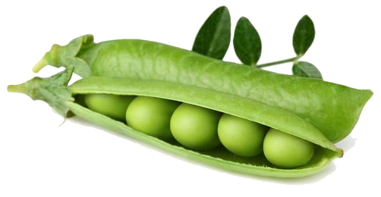
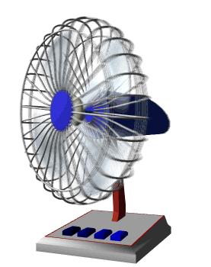
flatMap()
flatMap(Function<? super T,? extends Stream<? extends R>> mapper
flattens data in a stream

Slide 26
map() vs flatMap()

Slide 27

map()

Slide 28

map()

Slide 29

map()

Slide 30
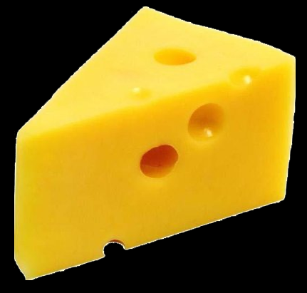
flatMap()

Slide 31
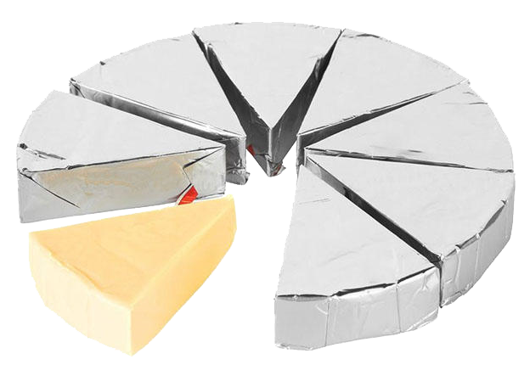
flatMap()
FP09_MoreFlatmapping

Slide 32
FP10_UniMaxDemo
FP11_DistinctByKey
FP12_Reductions_on_IntStream

Slide 33
Functional Approach to Data Processing
Suppose, we were tasked with printing out a list of the executives in our company's SPb branch office and tallying up their salary :
double res = employees.stream()
.filter(e -> e.getCity().equals("SPb"))
.filter(e -> e.getRole().equals(Role.EXECUTIVE))
.peek(e -> e.printSummary())
.mapToDouble(e -> e.getSalary())
.sum();
code reads like a problem
What are the advantages?
acts directly on the data set
is lazily evaluated
processing can be serial or parallel

Slide 34
Styles Compared
Imperative Programming
Functional Programming
Code deals with individual data items
Focused on "how"
Code does not read like a problem
Steps mashed together
Leaks extraneous details
Inherently sequential
Code deals with entire data set
Focused on "what"
Code reads like a problem
Well-factored
No "garbage variables" (temporary variables leaked into scope)
Code can be sequential or parallel

Slide 35
Parallel Stream
employees.stream()
.filter( . . . )
.filter( . . . )
.peek( . . . )
.mapToDouble( . . . )
.sum();

Slide 36
Parallel Stream
May provide better throughput
Multicores machines
GPUs
employees.parallelstream()
.filter( . . . )
.filter( . . . )
.peek( . . . )
.mapToDouble( . . . )
.sum();
Many factors affect performance
Data size, decomposition, packing, # of cores
Not a magic bullet
Parallel is not always faster

Slide 37
Parallel Stream
How it's being done

Slide 38
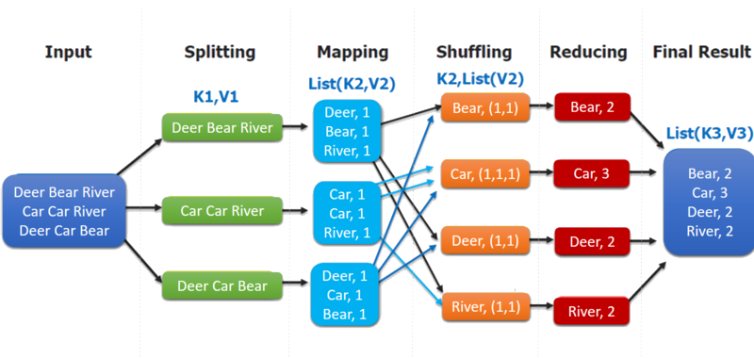
Parallel Stream
Map/Reduce via Fork/Join under the hood

Slide 39
Parallel Stream
employees.stream()
.filter( . . . )
.filter( . . . ))
.peek( . . . )
.mapToDouble( . . . )
.sum();

Slide 40
Parallel Stream
employees.stream()
.filter( . . . )
.filter( . . . ))
.peek( . . . )
.mapToDouble( . . . )
.parallel()
.sum();
.sequential()

Slide 41


Pipelines Fine Print
Stream pipelines are like Builders
Add a bunch of intermediate operations, and then execute
Cannot "branch" or "reuse" pipeline
Do NOT modify the source en route
Operation parameters must be stateless
Do not rely on any state that might change
This enables correct operation both sequentially or in parallel
Best to banish side effects completely

Slide 42
Avoid Statefullness
Will the result be the same?
double r1 = eList.stream()
.mapToDouble(Employee::getSalary)
.sequential().sum();
double r2 = eList.stream()
.mapToDouble(Employee::getSalary)
.parallel().sum();

Slide 43
Avoid Statefullness
What about now?
Optional<Employee> e1 = eList.stream()
.filter(e -> e.getRole().equals(Role.EXECUTIVE))
.sequential().findAny();
Optional<Employee> e2 = eList.stream()
.filter(e -> e.getRole().equals(Role.EXECUTIVE))
.parallel().findAny();
FP13_AvoidingStatefulness

Slide 44
FP14_PartitioningBy
FP15_GroupingBy

Slide 45
Reduction Fine Print
If the combining function is associative, reduction parallelizes cleanly
"Associative" means the order does not matter
In other words, the result is the same irrespective of the order used to combine elements
Examples: sum(), min(), max(), average(), count()
count() is equivalent to map(e -> 1).sum()
However: Passing a non-associative function to reduce() will yield a wrong answer. The function must be associative

Slide 46

Performance
Do not assume parallel is always faster
Parallel not always the right solution
Sometimes parallel is slower than sequential
Qualitative considerations
Does the stream source decompose well?
Do terminal operations have a cheap or expensive operation, e.g., merging?
What are stream characteristics?
Filters change size, for example
Primitive streams provided for performance
Autoboxing / unboxing negatively affects performance

Slide 47

A Simple Performance Model
Cost of the pipeline processing: Q x N, where
Q — processing cost per element
N — total number of elements in the pipeline
The larger is Q x N, the bigger are performance gains
easier to know N than Q
qualitative reasoning about Q
Complex pipelines might have
filters
limit() or skip()
complex reduction using groupingBy()

Slide 48
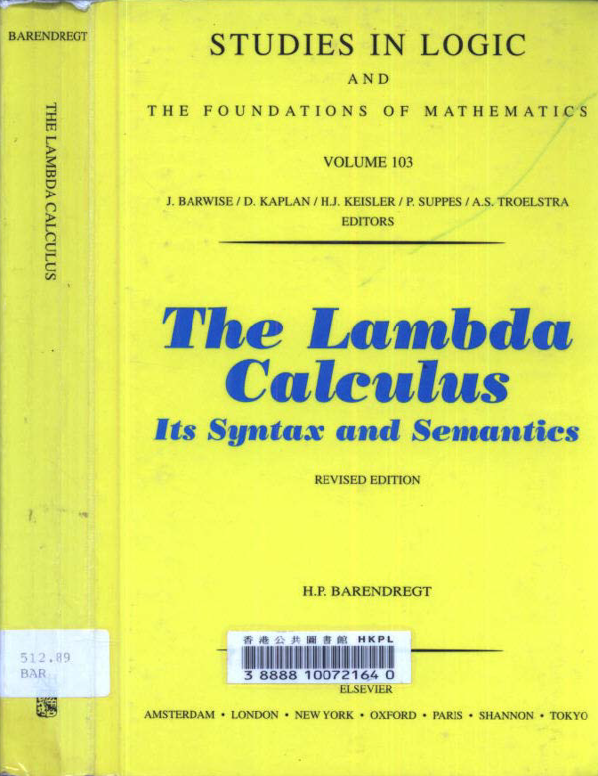
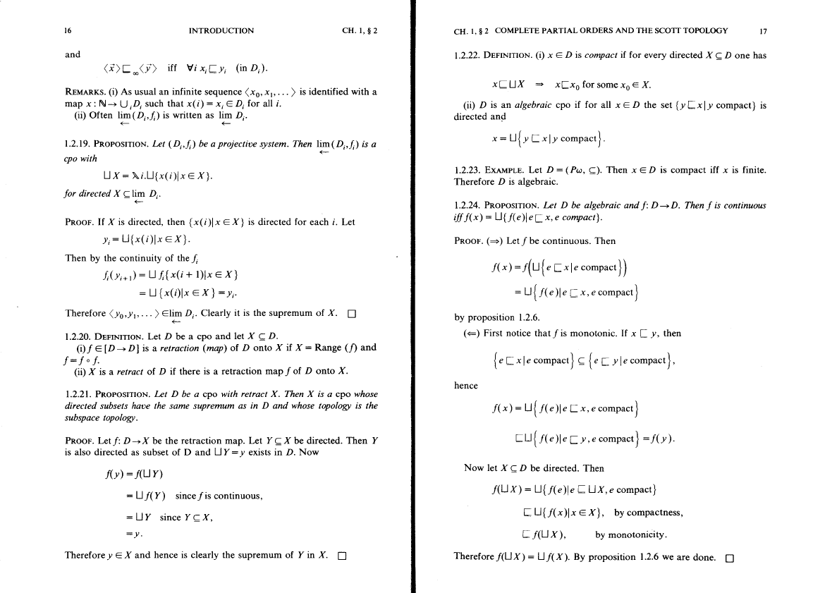

Slide 49

λ-Trader

